Slide 1

Stage 4 Double J Turn Course Designer: Eric Beerbaum
Carbine: 12 paper Handgun: 10 paper, 3 steel Sling Required(Unless you don’t have one, see procedure in that case)
The start position is hands touching the marks, Carbine loaded on the barrel. Handgun loaded and holstered.
On the audible start signal, engage all Carbine targets. Prior to engaging the last Carbine target(inside the hut), remove the magazine. Fire 1 and only 1 shot at the hut target to completely empty it. Sling Carbine. Then engage handgun targets. .

Slide 2
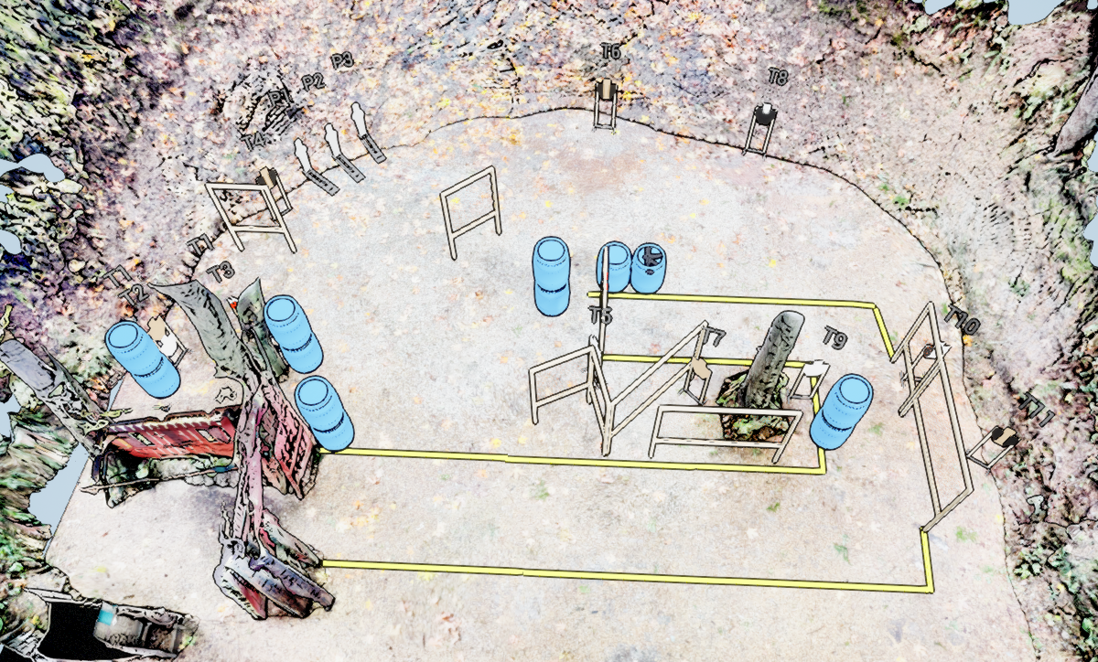
 | Stage 4 Double J Turn Course Designer: Eric Beerbaum

